Slide 1
Connecting to the Leader in YOU
Fall Board 2021 Washington State Organization DKG
Terri Diehm & Pat Bennett-Forman, facilitators
Notes:
Don’t forget to push the record button.
Pat
Welcome to Connecting to the Leader in YOU
Introductions: Terri Diehm (past state president 2015-17)
Pat Bennett-Forman (current state president)
Linda Elliott (president in 2009-2011) also assisted with the development of this session

Slide 2
Accepting a leadership position means one is willing to take on a challenge and ready to learn – not that one already knows all that is necessary to be an effective leader.
Jane Tanner DKG Collegial Exchange 85-2, p. 19
Notes:
Terri
Goal is to examine why members are reluctant to assume leadership roles and discuss strategies that can be taken at the personal and organization level to mitigate
concerns about being a leader.
It is important to realize that you don’t have to be a proven leader with prior experience to be a good leader; you just have to be willing to try.
Jane Tanner made this statement in an article she wrote for the DKG Collegial Exchange in which she attributes her leadership development to DKG. By the way, Jane has served as state president, regional director and on numerous DKG committees, as well as National President for her Mathematics Association. It all started with DKG.
Terri’s experience.
Pat – prep break out rooms – be sure each has a leader and that she has the questions and process

Slide 3
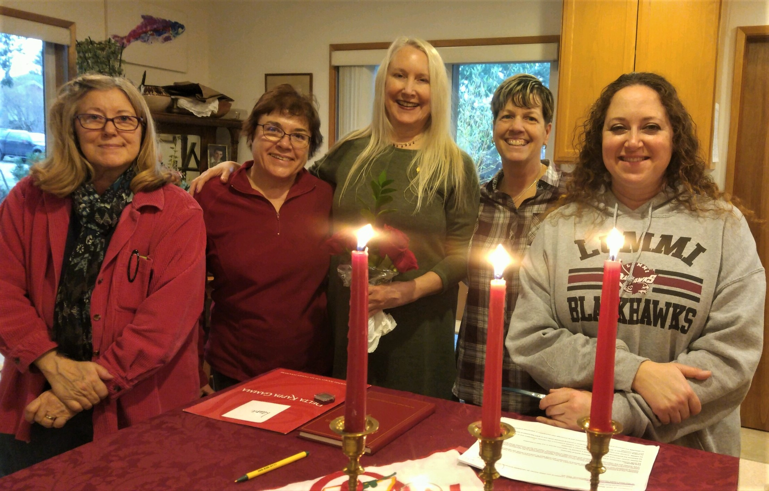
Leadership is essential for both organizational and personal growth.
Why were you invited to join DKG?
What made you accept membership? What did you expect to gain?
What value have you received from membership?
Notes:
Terri –
Leadership is essential for both organizational and personal growth.
Think about that for a minute and reflect on these questions. Why were you invited to join DKG? What made you accept? What were your expectations? What value have you received from your membership?
Get break out group leaders, be sure they have the questions.
Break out groups 7 minutes and then report out/ select a reporter 10 min. If someone has already said your items, just talk about new items.
Why were you invited to join?
Someone believed in you and in your potential (not just what you had already done)
What made you accept? What were your expectations?
Fellowship, affirmation, professional development
What value have you received from your membership?
DKG members support each other; they provide training opportunities; they mentor you along the way; one of their purposes to provide leadership growth opportunities
Leadership Management Seminar/ conferences
Presentation skills Committee participation

Slide 4
Issues in Leadership
Why do you (and others) hesitate to step up to Leadership positions?
Aging membership
Time for someone else to take a turn
Busy with other things (work, family, school)
Lethargic/not enough energy for the tasks
Don’t feel qualified/ can’t do it as well as ____________
Other
Notes:
Pat
One of the biggest threats to our organization’s sustainability is a lack of people willing to assume leadership positions.
Why do you think that is?
Please enter comments in the chat or raise your hand.
Some issues that have been identified include:
Aging membership I’m too old
Members have done that; its time for someone else to take a turn
Members, especially younger, are active with other things/commitments (work,, family, school)
People are lethargic, not enthused, don’t see why they should do it
Don’t feel qualified/ afraid they won’t measure up Think others don’t seem them as leaders
Sometimes these are legitimate; sometimes they are just excuses/rationalizations for fears we have.

Slide 5
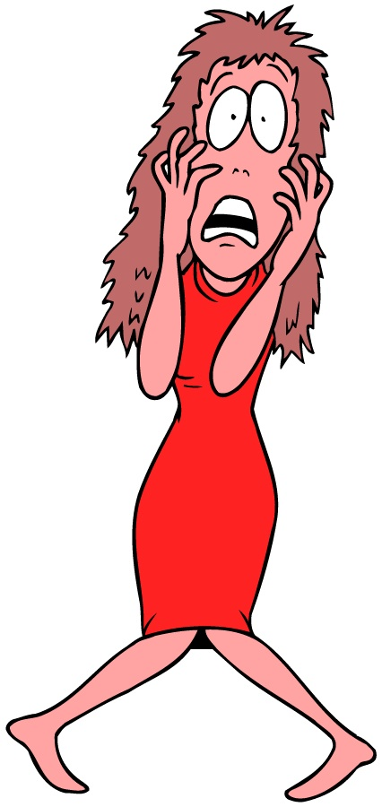
Research and experience says:
Vulnerability
Risk relationships
Afraid of Failing
Worry about the time/energy commitment
Concerned about support levels
Notes:
Pat
According to research, some of those fears include:
Making oneself vulnerable
Risking your image as . . . A capable person; a nice person; etc. imposter
Afraid that a leader role will put you at odds with friends not in leadership positions would they respond poorly to being given directions, etc.
What if I make a mistake? Will I “break” something? Will I be forgiven? Will I be criticized. What if I don’t have enough skills/knowledge
Do I have the time, energy, etc.
Do I have support? I can’t do it alone; I don’t know how; asking for help seems weak
Terri – join in with examples as appropriate

Slide 6
Mitigating Fears: organizational actions
Plan for identifying/nurturing leaders
Make tools/templates available
Mentor/ job shadow opportunities
Training opportunities
Start slow
Don’t ask new members to take on leadership roles immediately
Low stakes opportunities
From: Strategies for a Positive Chapter Environment
https://www.dkg.org/DKGMember/Resources/Chapter_Tools/Chapter_Strengthening
Notes:
Terri
Overcoming barriers happens at both the individual and the chapter level.
Chapters can do a great deal to mitigate fears by planning for succession.
Review points – allow for comments and additions
#6 Do Attend state meetings; serve on committees (even at state level)

Slide 7
What are your Leadership ASSETS?
Listen as we read out the following assets.
Put a tally mark for each one that applies to you.
What was your total?
Reflect on what leadership skills are evidenced by these assets.
Notes:
Terri
At the individual level, one needs to be willing to explore the possibility of leadership.
Still don’t believe that you are a potential leader?
Listen as we read out a list of activities and make a mark or tally for each that applies to you.
You are or were an educator
You use email
You belong to a DKG chapter
You have planned a vacation
You have had a mentor or been a mentor to a member or colleague
You have served on a committee related to your education assignment
You have led a meeting for DKG or any other organization
You have proposed a member for induction into DKG
You belong to another organization – church, community, service
You have attended a professional conference or convention
What was your total? If you have done these things, you are a leader or have the assets needed to be a leader.
How do these assets represent leadership skills?
Reflect on this question for a minute.

Slide 8
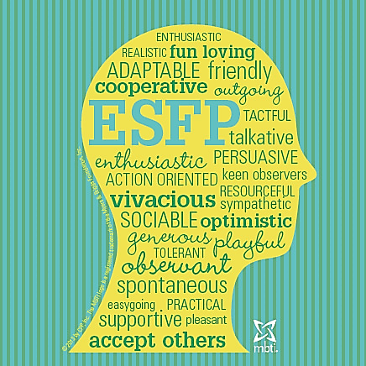
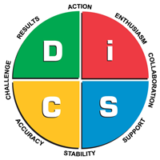
Discovering your style (DISC survey)
Notes:
Pat
There are many inventories on line and in academia to assess your personality and leadership styles.
We are going to look at some characteristics found in many of those inventories and ask you to discover your dominant tendencies for leadership.
Remember this as you take this survey. There are no right or wrong answers, no good or bad characteristics, no better or worse traits for determining how effective YOU will be as a leader.

Slide 9
#
1
2
3
4
5
6
7
8
9
10
11
12
A | B | C | D
steady | deliberate | direct | enthusiastic
detail oriented | persuasive | supportive | independent
determined | calm | out-going | willing
adaptable | people-oriented | problem solver | conscientious
positive | decisive | empathetic | analytical
influencer | determined | disciplined | consistent
quick | thoughtful | innovative | helpful
even paced | assertive | high energy | observant
thorough | collaborative | goal-oriented | cooperative
diplomatic | listener | out-of-box | strategic
persistent | receptive | inquisitive | fast moving
social | modest | bold | patient
Notes:
Pat
Take a sheet of paper and number it from 1 – 12
Look at the 4 words in each line; select the one word that BEST describes YOU.
Then next to the # on your paper put the letter from the column in which that word appears.
Example: line 1: steady deliberate direct enthusiastic. If I were to say “enthusiastic” I would enter the letter D next to #1 on my paper.; if I chose “deliberate” I would enter the letter B.
About 5 minutes. Ask folks to give you a thumbs up when they are done. Assess at 3 minutes and 4 minutes.

Slide 10
#
1
2
3
4
5
6
7
8
9
10
11
12
C | D | A | B
D | B | C | A
A | C | D | B
C | A | B | D
B | A | C | D
B | A | D | C
A | C | D | B
B | C | A | D
C | B | D | A
D | C | B | A
A | D | B | C
C | A | D | B
totals
Notes:
Pat
Now put a square, triangle, circle and arrow on your paper to make 4 columns
Then enter your response in the appropriate column. My enthusiastic - response D for question 1 would go in the triangle column My deliberate. Response B – would go in the arrow column. You will have only one letter entered for each numbered line and only one column filled in for each line.
Then add the number of responses you had for each column
The highest number is your preference or greatest tendency.
Give about 3-5 minutes.
Now let’s see what they mean.

Slide 11
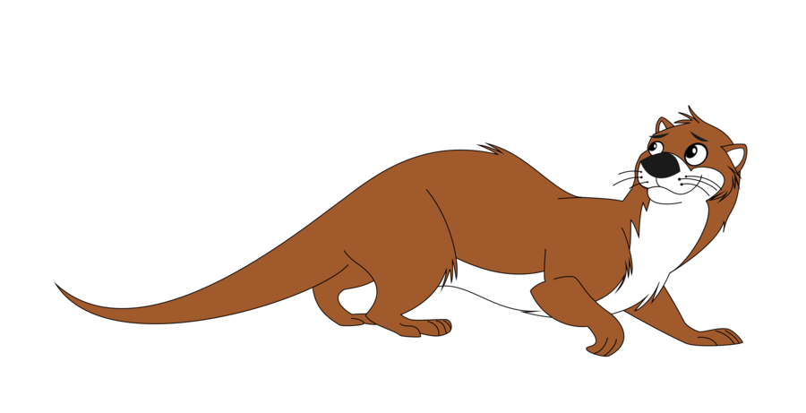
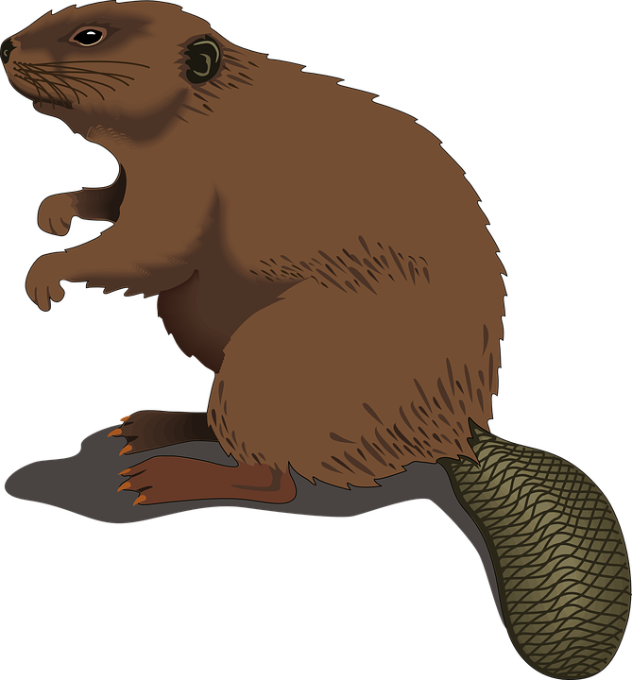
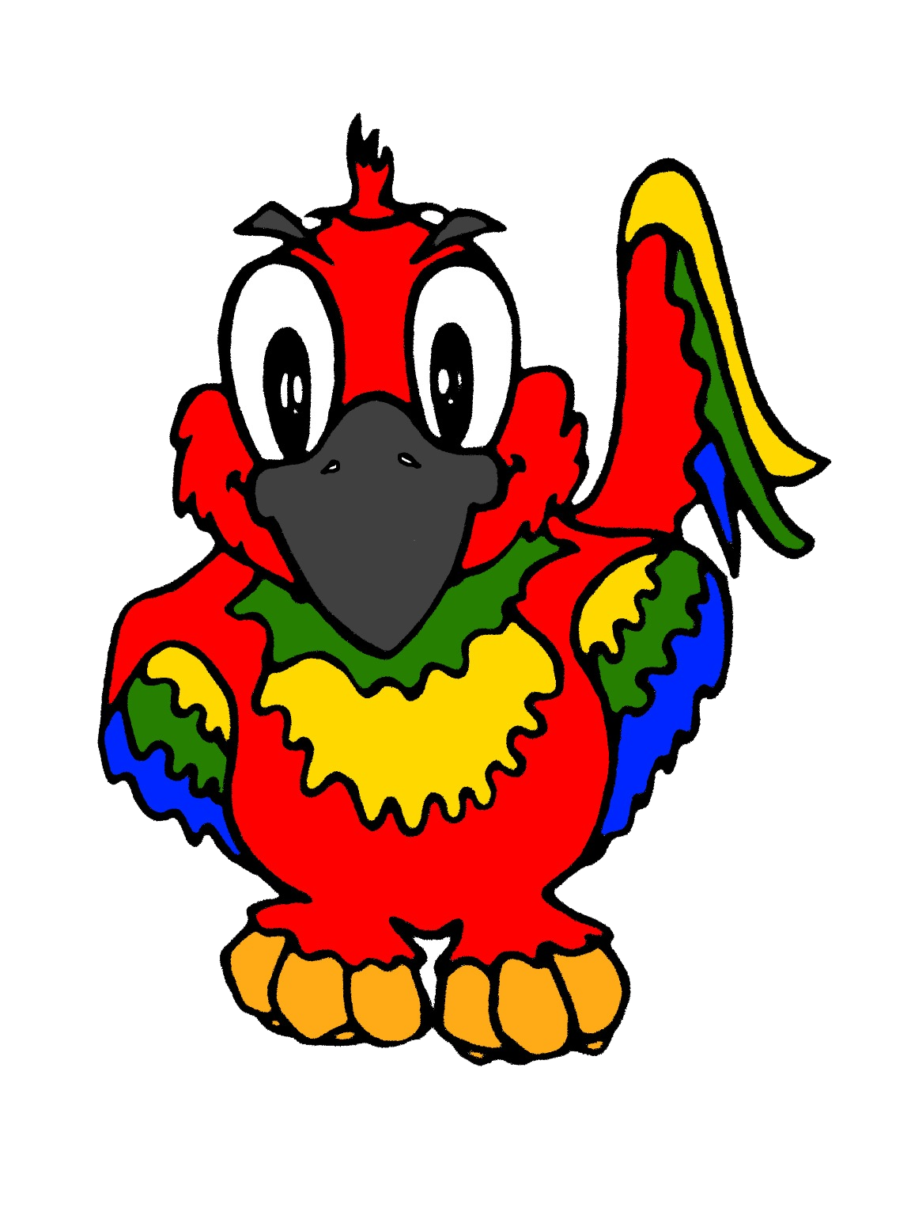
Discovering your style
DOVE/DOG/ PEACENIK
EAGLE/LION/TORPEDO
PARROTT/OTTER/FIREWORKS
OWL/BEAVER/
ZOOM LENSE
Notes:
Pat
Square is sometimes referred to as D Driver/dominant/director 10% associated with a lion, and eagle or a torpedo - straight to the point, forceful
Triangle is sometimes referred to as Influencer 25% associated with an otter, monkey, parrot or fireworks – energetic, out of the box personality, motivates others to participate
The circle represents the S Supporter 40% associated with dogs (steady/loyal), doves and peacemakers –likes to diminish or avoid conflict; stable persons, careful of emotional needs of others The arrow sometimes referred to as C Conscientious 25%
associated with beavers, owls, or zoom lenses – busy as a --, focused on the getting things right, detail oriented
People sometimes think that they don’t have the appropriate style or traits of a leader – they may not be highly organized or assertive, for example Or don’t attend well to details. But really, each of these styles contain strengths needed by effective leaders.
What is a really valuable tendency found in the D dominant tendency?
(answers will vary)
How about the I influencer style?
Name some valuable leadership characteristics of the S supportive style.
And, last but not least, what does the C conscientious leader bring to the table?

Slide 12
Style strengths Growth needs
Let’s get it done attitude
Quick decision maker
Problem solver
Likes challenges
Verbalize reasons for conclusions
Consider emotional needs of others
Listen more effectively/respectfully
Slow down the decision process
D
Contacts & engages people
Generates motivation/enthusiasm
Positive outlook
Likes group participation
Set and keep timelines
Be more objective with decisions
Talk less and listen more
Attend to details; follow-thru
I
Notes:
Pat
Each style has, as you have seen, certain characteristics or tendencies – certain strengths that they bring to a leadership position
Each also has needs or areas for improvement to be truly effective leaders.
Review each

Slide 13
Creates stability/harmony
Patient and loyal
A good listener, people centered
Consistent & predictable
Set limits with others
Be involved in more than one thing
Encourage creativity
See conflict as part of the solution
S
Analytical and detail oriented
Accurate, timely, systematic
Diplomatic with people
Inquisitive, imaginative
Learn to delegate
Exhibit enthusiasm and praise effort
Make decisions w/o all the facts
Facilitate discussion/communicate
C
Notes:
Pat
Review tendencies/strengths and the areas these leaders are weakest in.
There are essential leadership qualities in all these style tendencies and there is room for growth in each. The lesson is that no one is perfect for the job but we are all capable of using our strengths and learning to borrow from others to enhance our performance.

Slide 14
Wherever you come from,
Whatever your style
YOU can be a successful LEADER
Notes:
Terri
The BIG take-away is that wherever you come from, whatever your style.
YOU can be a successful LEADER
You need to know how to communicate effectively (both in output and in listening)
You need to know how to work as a TEAM (together everyone achieves more)
You need to be able to delegate to people’s strengths and away from weaknesses (including your own)
But no matter what your style YOU have it in you to be an effective leader.

Slide 15
Mitigating Fears: personal actions
Know yourself (assets/style/vision); adopt a positive mindset
Know your team (what do they need from you; what can they do for you - delegate)
Ask for what you need (get a mentor); learn new skills
Accept feedback and support
Find the energy (prioritize; practice self-care)
Notes:
Terri
To review: the individual actions that can be taken to make one more confident in their leadership capabilities
Are:
(read from slide)
1. Know yourself - Over 40% of leaders report having self-doubt but they take action anyway Have a positive Mindset: practice positive self-talk; practice public speaking
Display open body language, smiles, show interest in people (this builds trust)
Know your team (what do their styles suggest your behaviors with them need to be) and how to take advantage of their strengths; learn to delegate.
3. Ask for what you need – get a mentor, take training to develop your weaker areas and
build skills – ask for help to learn what you don’t know; if speaking out is not a strength, learn strategies to get your voice out there. If you are not detail oriented, learn some strategies and delegate to those who are, etc. 4. Accept feedback and support. Be authentic-
Leadership is not about being a loud charismatic person who walks into a room and attracts attention. Instead a leader is someone who influences others, guides others.
5. To find the energy, learn to plan, keep a calendar, prioritize; delegate; and finally, take care of yourself through exercise, meditation, yoga, time for yourself, spa time!.

Slide 16
Be the leader that you would follow
Has a sense of direction/vision
Communicates well succinct and clear listens asks questions
Is transparent/ high integrity
Collaborates/includes/delegates/respects
Notes:
Terri
You already have the Qualities of good leaders – you have assets, you know your style, and you know what you need to do to mitigate your weaknesses.
So you CAN be the leader that you would follow, you also display qualities
Of vision, communication, integrity and collaboration.
If that describes you, you are or can be a successful leader.
Others can help you with parliamentary procedure, finances, knowing what is tasks are to be done by when, etc. It’s the core that makes a good leader and YOU already have that.

Slide 17
What do YOU need from WSO to be a confident leader?
Notes:
Pat
To become a leader, you may need to leave your comfort zone – we encourage you to do that – for there is no growth in the comfort zone. BUT . . .
We recognize that you will also need support from the WSO state level.
Let’s take a few minutes now to hear what your needs are – what can we do to help?
Activity to get member input - just put it in the chat.
Enter your comments/ wishes in the
Chat box.

Slide 18
If your actions create a legacy that inspires others to dream more,
Do more,
And become more,
Then, you are an excellent leader.
Dolly Parton
Notes:
Terri
In conclusion we would like to share this quote about leadership from Dolly Parton.
Wise words from a wise women,
affirming that you are already a leader.

Slide 19
Gratitude
A poem by
FACE
Focus on potential instead of limitations.
Avoid comparing your beginning to someone else’s middle.
Celebrate your uniqueness! No one can shine exactly like you.
Encourage others by helping them attain their personal goals.
Find the hidden leader in YOU.
Notes:
Terri read gratitude quote.
Pat
We hope that today we have inspired you to “Find the hidden leader in yourself, to be brave and willing to examine your leadership potential, and to harness a desire to help grow our organization - because DKG is made stronger by your leadership participation.
We also hope that as chapters you will take the opportunity to develop and plan for leadership succession, taking into account strategies to mitigate the barriers and discovering the potential leaders (whatever their style) in your chapter.
Brenda Johnson, current president of Oregon DKG says that
“Involvement creates leadership which empowers you and DKG.”
We encourage your involvement and look forward to your leadership.

Slide 20
Thank you for participating
Resources will be made available on the state website.
Others may be found on the International site under Resources/Leadership.
Notes:
Pat
This power point will be put on the state web site and Terri, Linda Elliott and I are available to present it to areas and chapters upon request.
We also encourage you to delve into the other resources on the International web site under Resources/Leadership.
Your feedback on how helpful this session has been is welcomed as are your suggestions for improvement. Thank you.

